Slide 1
DNS and Attacks

Slide 2
Outline
DNS Hierarchy,Zones,and Servers
DNS Query Process
DNS Attacks : Overview
Local DNS Cache Poisoning Attack
Remote DNS Cache Poisoning Attack
Reply Forgery Attacks from Malicious DNS Servers
DNS Rebinding Attack
Protection Against DNS Cache Poisoning Attacks
Denial of Service Attacks on DNS Servers

Slide 3
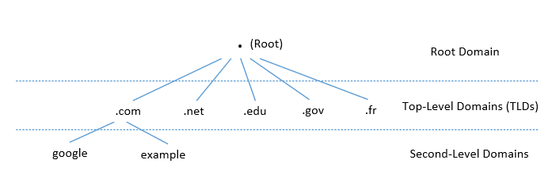
DNS Domain Hierarchy
Domain namespace is organized in a hierarchical tree-like structure.
Each node is called a domain, or subdomain.
The root of the domain is called ROOT, denoted as ‘ . ‘.
Below ROOT, we have Top-Level Domain (TLD). Ex: In www.example.com, the TLD is .com.
The next level of domain hierarchy is second-level domain which are usually assigned to specific entities such as companies, schools etc

Slide 4
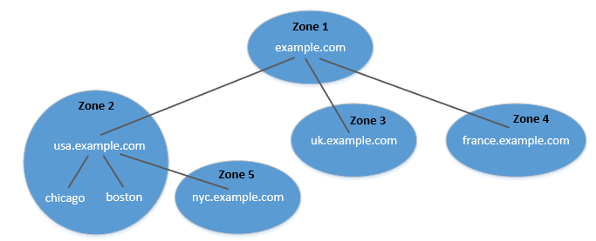
DNS Zone
DNS is organized according to zones.
A zone groups contiguous domains and subdomains on the domain tree and assign management authority to an entity.
The tree structure depicts subdomains within example.com domain.
In this case, there are multiple DNS zones one for each country. The zone keeps records of who the authority is for each of its subdomains.
The zone for example.com contains only the DNS records for the hostnames that do not belong to any subdomain like mail.example.com

Slide 5
Zone vs Domain
A DNS zone only contains a portion of the DNS data for a domain.
If a domain is not divided into subdomains, the zone and domain are essentially the same, because the zone contains all the DNS data for the domain.
When a domain is divided into subdomains, their DNS data can still be put in the same zone, so domain and zone are still the same.
But subdomains can have their own zones.
usa.example.com is a domain with subdomains as boston, nyc and chicago. Two zones are created for usa.example.com. First contains usa domain, chicago and boston subdomain and second contains nyc subdomain.

Slide 6
Authoritative Name Servers
Each DNS zone has at least one authoritative nameserver that publishes information about the zone.
It provides the original and definitive answers to DNS queries.
An authoritative name server can be a master server (primary) or slave server (secondary).
A master server stores the master copies of all zone records whereas a slave server uses an automatic updating mechanism to maintain an identical copy of the master records.

Slide 7
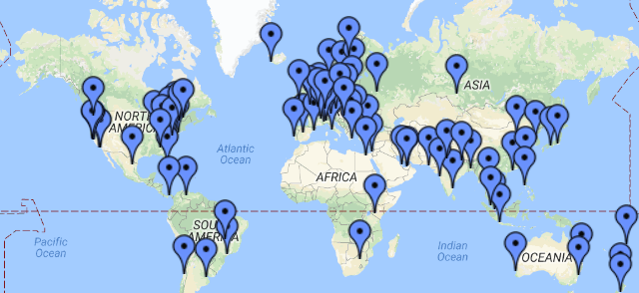
DNS ROOT Servers
The root zone is called ROOT.
There are 13 authoritative nameservers (DNS root servers) for this zone.
They provide the nameserver information about all TLDs
https://www.internic.net/domain/root.zone
They are the starting point of DNS queries.

Slide 8
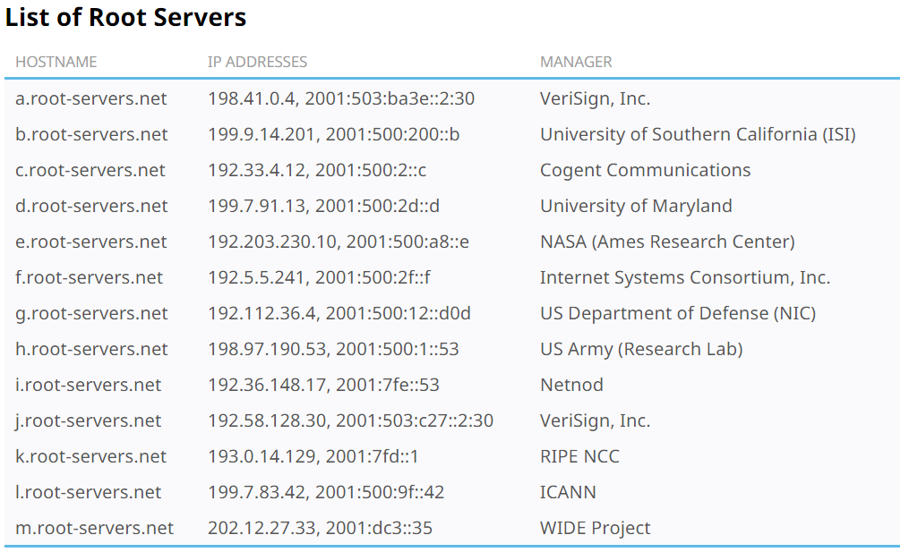
13 DNS Root Servers
They are the most critical infrastructure on the Internet.

Slide 9
Top Level Domain (TLD)
Infrastructure TLD: .arpa
Generic TLD (gTLD): .com, .net,
Sponsored TLD (sTLD): These domains are proposed and sponsored by private agencies or organizations that establish and enforce rules restricting the eligibility to use the TLD: .edu, .gov, .mil, .travel, .jobs
Country Code TLD (ccTLD): .au (Australia), .cn (China), .fr (France)
Reserved TLD: .example, .test, .localhost, .invalid

Slide 10
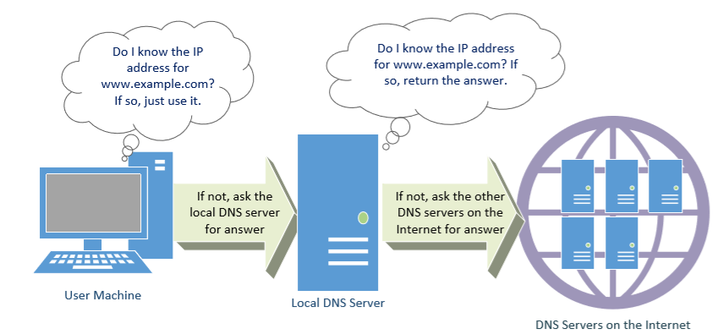
DNS Query Process

Slide 11
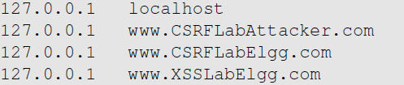
Local DNS Files
/etc/host: stores IP addresses for some hostnames. Before machine contacts the local DNS servers, it first looks into this file for the IP address.
/etc/resolv.conf: provide information to the machine’s DNS resolver about the IP address of the local DNS server. The IP address of the local DNS server provided by DHCP is also stored here.

Slide 12
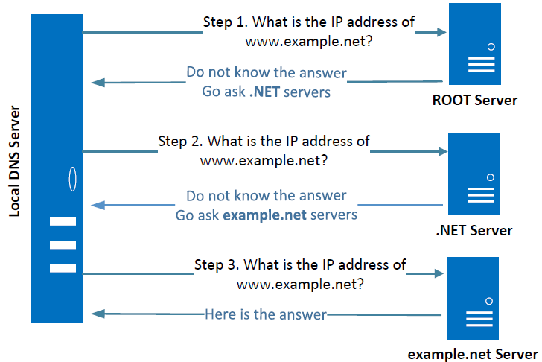
Local DNS Server and Iterative Query Process
The iterative process starts from the ROOT Server. If it doesn’t know the IP address, it sends back the IP address of the nameservers of the next level server (.NET server) and then the last level server (example.net) which provides the answer.
Notes:
The Local DNS servers need not be local. They may or may not be set up in the local network. Google Public DNS is a DNS service offered by Google, serving any host on the Internet.

Slide 13
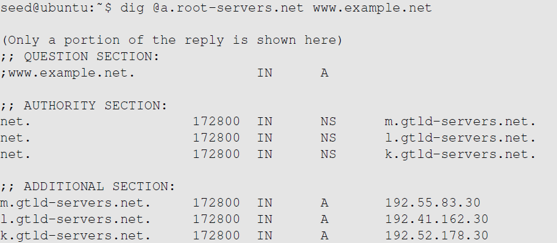
Emulating Local DNS Server (Step 1: Ask ROOT)
Directly send the query to this server.
No answer (the root does not know the answer)
Go ask them!

Slide 14
DNS Response
There are 4 types of sections in a DNS response :
Question section : Describes a question to a nameserver
Answer section : Records that answer the question
Authority section : Records that point toward authoritative nameservers
Additional section : Records that are related to the query.
In the above example, we see that as root server doesn’t know the answer there is no answer section, but tells us about the authoritative nameservers (NS Record) along with their IP addresses in the Additional section (A record).

Slide 15
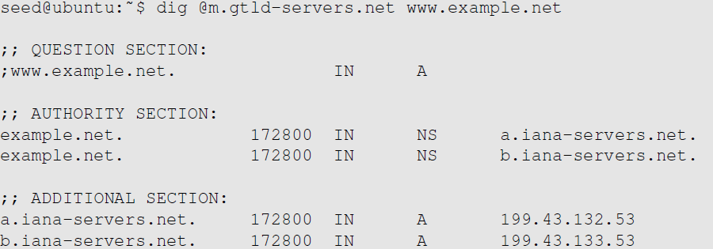
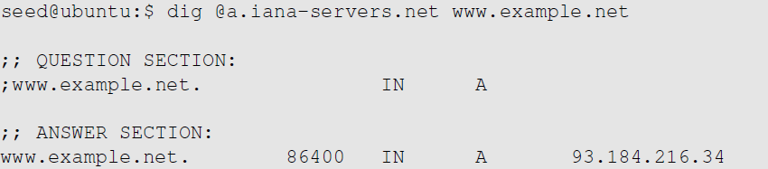

Steps 2-3: Ask .net & example.net servers
Ask a .net nameservers.
Go ask them!
Ask an example.net nameservers.
Finally got the answer

Slide 16
DNS cache
When the local DNS server gets information from other DNS servers, it caches the information.
Each piece of information in the cache has a time-to-live value, so it will be eventually time out and removed from the cache.

Slide 17
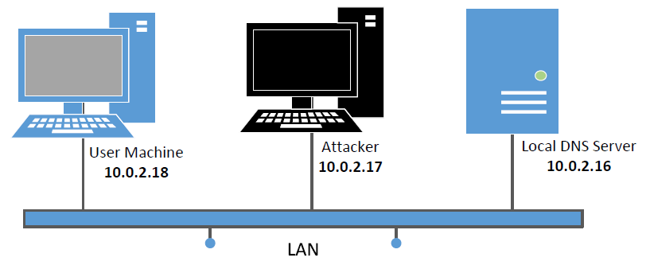
Set Up DNS Server and Experiment Environment
We will use this setup for our experiment

Slide 18
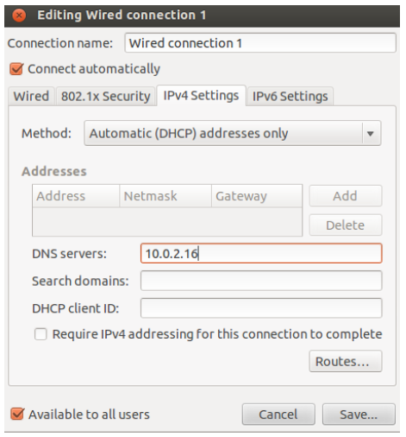
Setup: User Machine
Need to modify /etc/resolv.conf
DHCP may overwrite this file, we need to tell DHCP client to manually set the DNS server in this file, and then never modify it thereafter.

Slide 19

Setup: Configure Local DNS Server
Install BIND 9 DNS server: sudo apt-get install bind9
Configure BIND 9 server
BIND 9 gets its configuration from /etc/bind/named.conf,
The file contains several “include” entries. One of the entries is “/etc/bind/named.conf.options”.In this file, we can specify where the DNS cache is to be dumped.
Commands related to DNS cache

Slide 20


Configure Local DNS Server: Simplification
Turn Off DNSSEC: DNSSEC is used to protect against spoofing attacks on DNS servers. To simplify our experiment, we need to turn it off. Modify named.conf.options:
Use fixed source port (to simplify our experiment): Modify named.conf.options
Restart DNS Server: sudo service bind9 restart

Slide 21
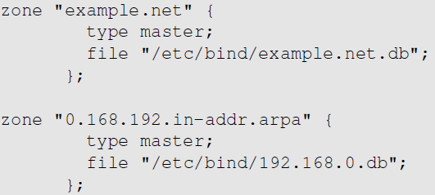
Set Up DNS Zones on Local DNS Server
Create zones: Create two zone entries in the DNS server by adding them to /etc/bind/named.conf.
For forward lookup (Hostname → IP).
For reverse lookup (IP → hostname).

Slide 22
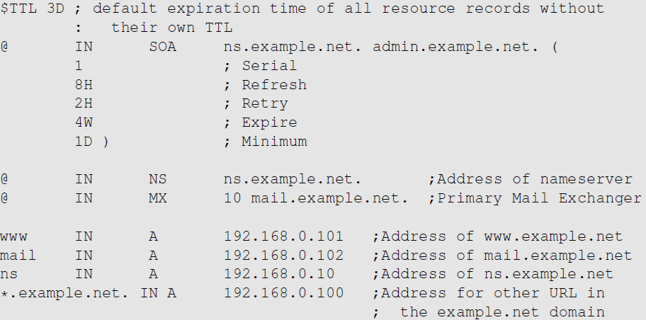
Zone File for Forward Lookup
/etc/bind/example.net.db (The file name is specified in named.conf)
@: Represents the origin specified in named.conf (string after “zone”) [example.net]

Slide 23
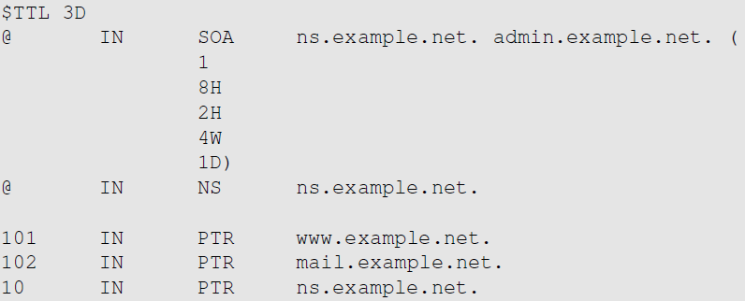
Zone File for Reverse Lookup
/etc/bind/192.168.0.db: (The file name is specified in named.conf)

Slide 24
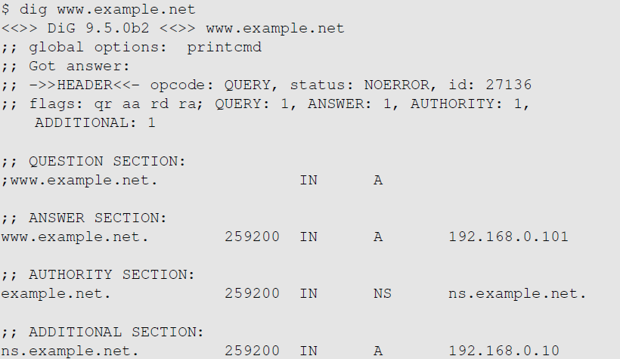
Testing Our Setup

Slide 25
DNS Attacks
Denial-of-Service Attacks (DoS): When the local DNS servers and the authoritative nameservers do not respond to the DNS queries, the machines cannot retrieve IP addresses which essentially cuts down the communication.
DNS Spoofing Attacks:
Primary goal: provide a fraudulent IP address to victims, tricking them to communicate with a machine that is different from their intention.
Example: If a user’s intention is to visit a bank’s web site to do online banking, but the IP address obtained through the DNS process is attacker’s machine, the user machine will communicate to the attacker’s web server.

Slide 26
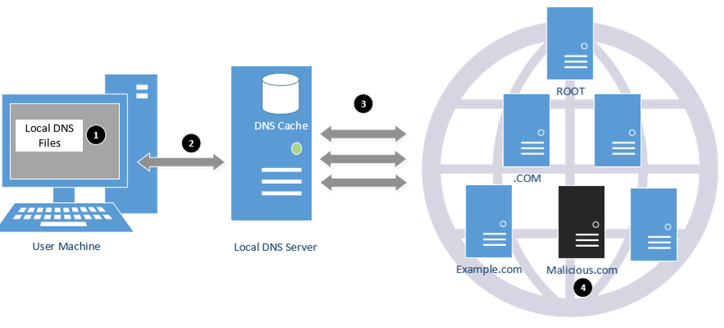
Overview of the Attack Surfaces

Slide 27
DNS Attacks on Compromised Machines
If attackers have gained the root privileges on a machine,
Modify /etc/resolv.conf: use malicious DNS server as the machine’s local DNS server and can control the entire DNS process.
Modify /etc/hosts: add new records to the file, providing the IP addresses for some selected domains. For example, attackers can modify IP address of www.bank32.com which can lead to attacker’s machine.

Slide 28
Local DNS Cache Poisoning Attack

Slide 29
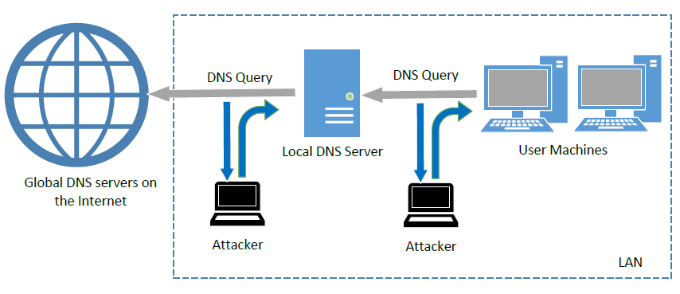
Spoofing DNS Replies (from LAN)
Notes:
Attacks on user machines : When the user machine sends out a DNS query to its local DNS server, attacker can immediately send a spoofed reply, using local DNS as its source IP address. Attackers can put any arbitrary IP address in the reply.
Attacks on local DNS server : Cache Poisoning attack : When the local DNS server sends out iterative queries to get an answer from the DNS servers on the Internet, attackers can send out spoofed replies to the local DNS server. They get accepted as long as they arrive before the actual replies. This is called DNS cache poisoning.

Slide 30
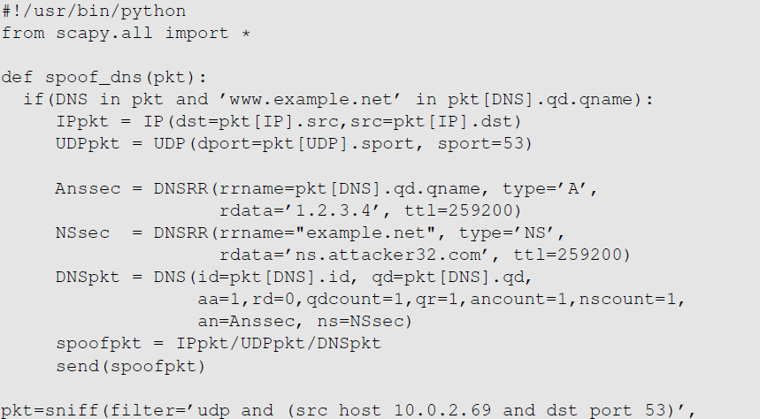
Local DNS Cache Poisoning Attack
Goal: Forge DNS replies after seeing a query from Local DNS Server

Slide 31
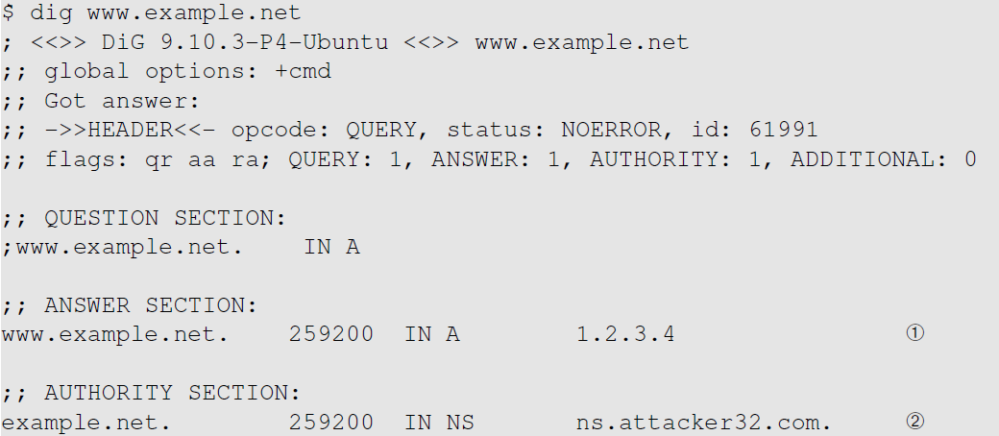
Local DNS Cache Poisoning Attack
Notes:
IP address of Local DNS server: 10.0.2.16
Forged reply: Map www.example.net to 10.20.30.40

Slide 32
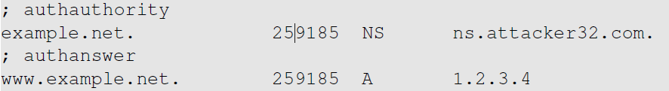
Inspect the Cache
Run “sudo rndc dumpdb –cache” and check the contents of “/var/cache/bind/dump.db”.
Clean the cache using “sudo rndc flush” before doing the attack.
Notes:
The above attack only targets the Answer section in the reply which affects only the hostname. We can also forge the authority section (NS record) so that when the victim local DNS server tries to find any IP address in the target domain, it will send a request to the malicious nameserver specified in the fake NS record which affects all the hostnames in the target domain.

Slide 33
Remote DNS Cache Poisoning Attack

Slide 34
Challenges
Challenges: For remote attackers who are not on the same network as the local DNS server, spoofing replies is much more difficult, because they need to guess two random numbers used by the query packet:
Source port number (16-bit random number)
Transaction ID (16-bit random number)
Cache effect: If one attempt fails, the actual reply will be cached by local DNS server; attacker need to wait for the cache to timeout for the next attempt.

Slide 35
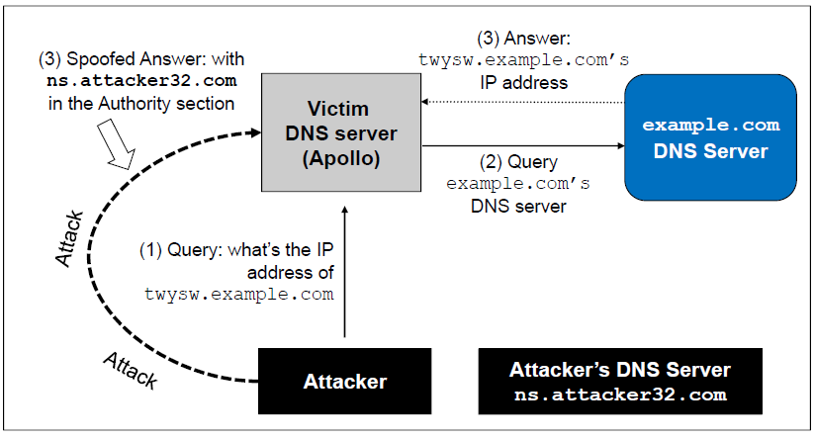
The Kaminsky Attack
How can we keep forging replies without worrying about the cache effect?
Kaminsky’s Idea:
Ask a different question every time, so caching the answer does not matter, and the local DNS server will send out a new query each time.
Provide forged answer in the Authority section
Notes:
Twysw.example.com is a random name
While Apollo waits for the reply, the attacker floods Apollo with a stream of spoofed DNS replies each with a different transaction ID and UDP destination port. The attacker also provides an NS record showing ns.attacker32.com as the nameservere. A different name will be used in the next attempt.
If the spoofed DNS response fails, the attacker will go back to the first step and repeat the steps but with a different hostname. This defeats cache effect.

Slide 36
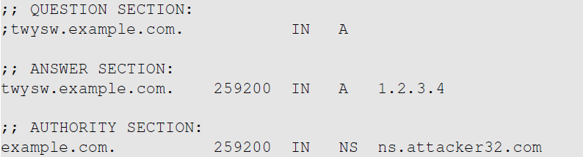
The Kaminsky Attack: A Sample Response
This random name will change for each attack attempt
This answer does not matter
This is what we want the local DNS server to cache
Tell the DNS server to use this one as the nameserver for the example.com domain

Slide 37
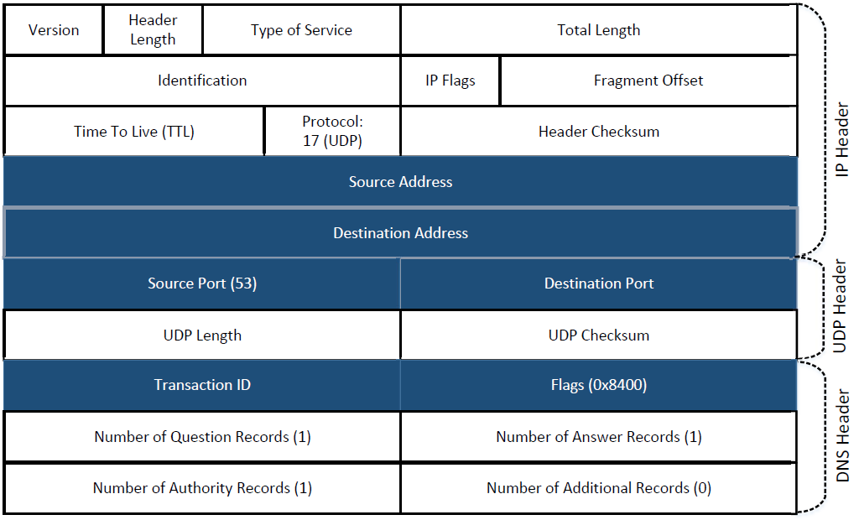
Spoofing Replies: IP and UDP headers

Slide 38
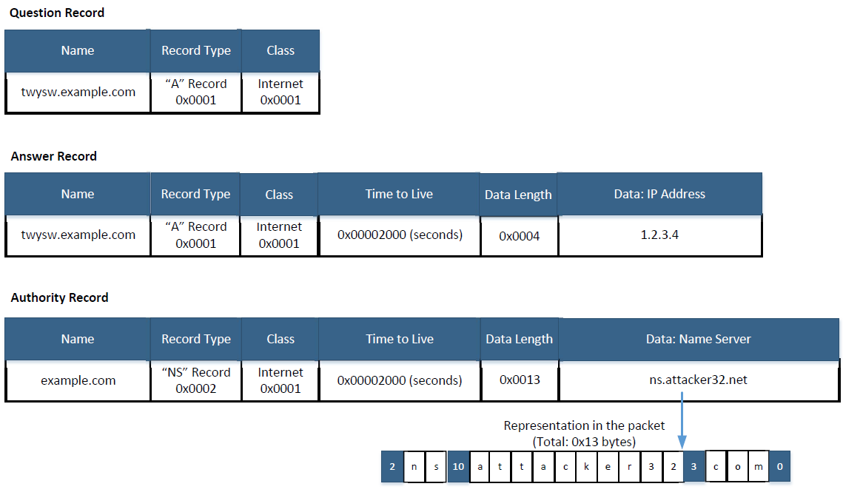
Spoofing Replies: DNS Header and Payload

Slide 39
Attacks from Malicious DNS Server

Slide 40
Attacks from Malicious DNS Server
When a user visits a website, such as attacker32.com, a DNS query will eventually come to the authoritative nameserver of the attacker32.com domain. In addition to providing an IP address in the answer section of the response, DNS server can also provide information in the authority and additional sections. Attackers can use these sections to provide fraudulent information.

Slide 41
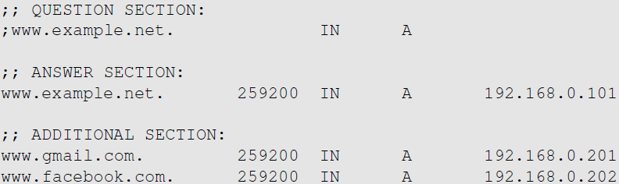
Fake Data in the Additional Section
Additional information is provided
They will be discarded: out of zone. They will cause security problems if not discarded.
Notes:
When answering the query about www.example.net, the authoritative nameserver tells the client IP addresses for some popular domain names.
If the fake information is accepted by the client (local DNS server), DNS cache will be poisoned with these fraudulent IP addresses.
As the information is out of zone, it will be discarded by the client.

Slide 42
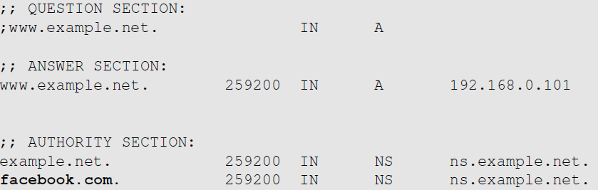
Fake Data in the Authority Section
This one is allowed
This one is out of zone, and should be discarded

Slide 43
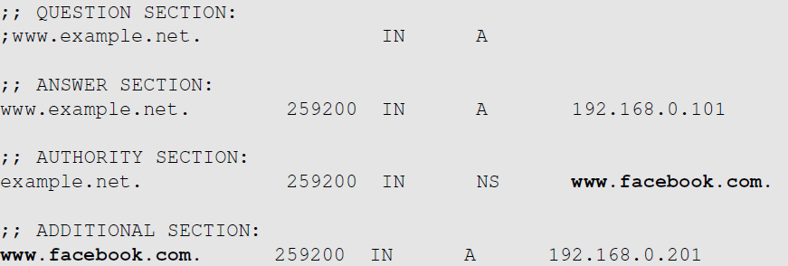
Reply Forgery Attacks from Malicious DNS Servers
This one is allowed
This one is not allowed (out of zone). The local DNS server will get the IP address of this hostname by itself.

Slide 44
Reply Forgery in Reverse DNS Lookup
In the reverse lookup, a DNS query tries to find out the hostname for a given IP address.
Question: Can we use the hostname obtained from reverse DNS lookup as the basis for access control?
Example: Packets from syr.edu are allowed to access certain services.
To answer this question, we need to know how to do reverse lookup

Slide 45
Reply Forgery Attacks from Malicious DNS Servers
Example :
Given an IP address, 128.230.171.184, the DNS resolver constructs a “fake name” 184.171.230.128.in-addr.arpa and then send queries through an iterative process.
We emulate the entire reverse lookup process using @ option in the dig command.

Slide 46
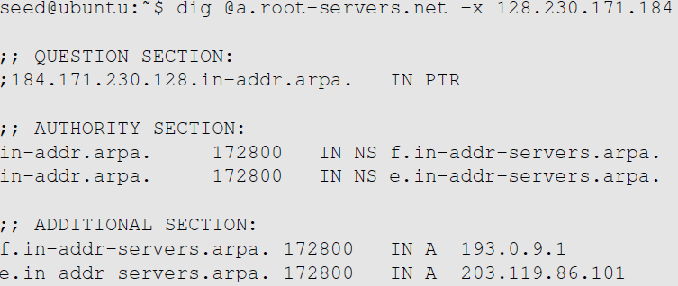
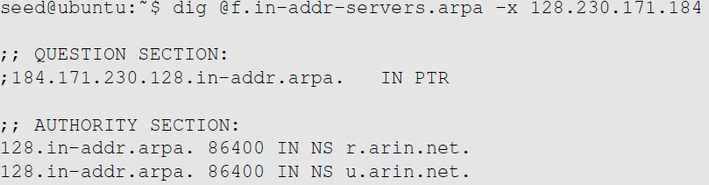
Reverse DNS Lookup
Step 1: Ask a root server. We get the nameservers for the in-addr.arpa zone.
Step 2: Ask a nameserver of the in-addr.arpa zone. We get nameservers for the 128.in-addr.arpa zone

Slide 47
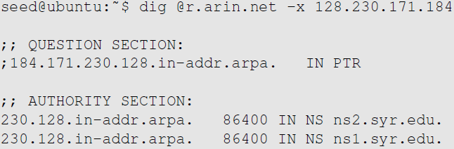
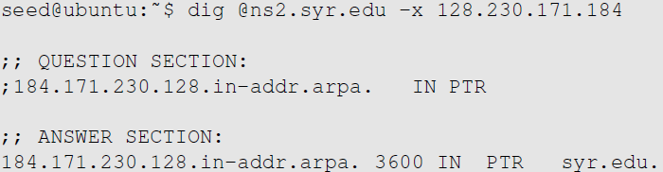
Reply Forgery Attacks from Malicious DNS Servers
Step 3: Ask a nameserver of the 128.in-appr.arpa zone. We get the nameservers for the 203.128.in-addr.arpa zone
Step 4: Ask a nameserver of the 230.128.in-appr.arpa zone. We get the final result

Slide 48
Review Our Question
Question: Can we use the hostname obtained from reverse DNS lookup as the basis for access control?
Answer:
If a packet comes from attacker, the reverse DNS lookup will go back to the attacker’s nameserver.
Attackers can reply with whatever hostnames they want.

Slide 49
Protection Against DNS Cache Poisoning Attacks
DNSSEC
DNSSEC is a set of extension to DNS, aiming to provide authentication and integrity checking on DNS data.
With DNSSEC, all answers from DNSSEC protected zones are digitally signed.
By checking the digital signatures, a DNS resolver is able to check if the information is authentic or not.
DNS cache poisoning will be defeated by this mechanism as any fake data will be detected because they will fail the signature checking.

Slide 50
Protecting Against DNS Cache Poisoning Attacks

Slide 51
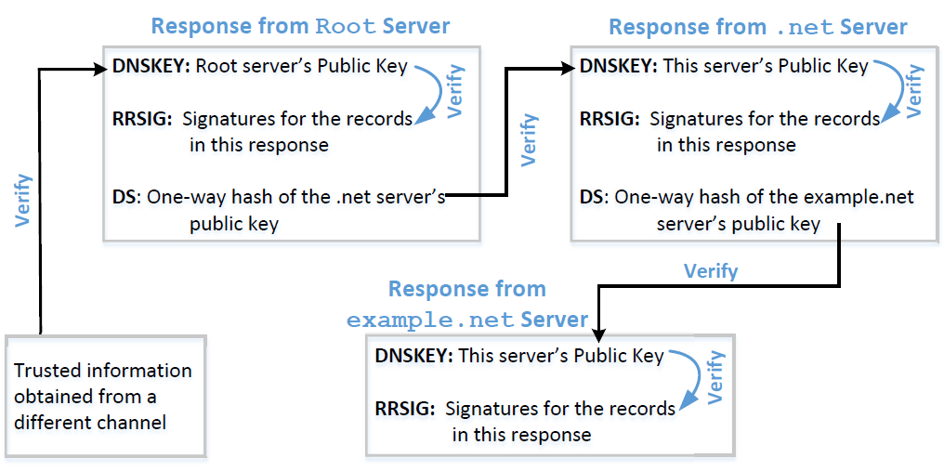
Protection Using DNSSEC
Notes:
Components of DNSSEC :
RRSIG : Contains the digital signature for a record set.
DNSKEY : Signature is verified using the public key in the DNSSEC record.
Along with these two, the one-way hash value of the public key has to be provided by the sender’s parent zone using the DS record.
Verification Process:
Chain of trust : The public key of a child zone is signed by its parent zone.The root of the trust falls on the nameservers of the nameservers of the root zone. These nameservers are called trust anchors and are typically obtained with the operating system.

Slide 52
Protection Using TLS/SSL
Transport Layer Security (TLS/SSL) protocol provides a solution against the cache poisoning attacks.
After getting the IP address for a domain name (www.example.net) using DNS protocol, a computer will ask the owner (server) of the IP address to proof that it is indeed www.example.net.
The server has to present a public-key certificate signed by a trusted entity and demonstrates that it knows the corresponding private key associated with www.example.net (i.e., it is the owner of the certificate).
HTTPS is built on top of TLS/SSL. It defeats DNS cache poisoning attacks.

Slide 53
DNSSEC versus TLS/SSL
Both DNSSEC and TLS/SSL are based on the public key technology, but their chains of trust are different.
DNSSEC provides chain of trust using DNS zone hierarchy, so nameservers in the parent zones vouch for those in the child zones.
TLS/SSL relies on Public Key Infrastructure which contains Certificate Authorities vouching for other computers.

Slide 54

DNS Rebinding Attack
Firewall
Web page with JavaScript code
Same Origin Policy
Attacker
The target server
(vulnerable)
Attack goal: interact with the target server from outside

Slide 55
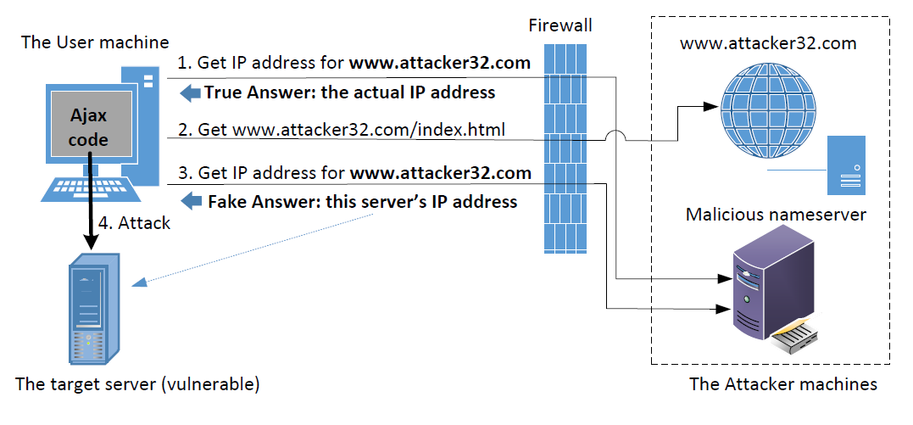
DNS Rebinding Attack

Slide 56
Denial of Services Attacks on DNS

Slide 57
Denial of Service Attacks on Root Servers
Attacks on the Root and TLD Servers :
Root nameservers: If the attackers can bring down the servers of the root zone, they can bring down the entire Internet. However, attack root servers is difficult:
The root nameservers are highly distributed. There are 13 (A,B….M) root nameservers (server farm) consisting of a large number of redundant computers to provide reliable services.
As the nameservers for the TLDs are usually cached in the local DNS servers, the root servers need not be queried till the cache expires (48 hrs). Attacks on the root servers must last long to see a significant effect.

Slide 58
Denial of Service Attacks on TLD Servers
Nameservers for the TLDs are easier to attack. TLDs such as gov, com, net etc have quite resilient infrastructure against DOS attacks. But certain obscure TLDs like country-code TLDs do not have sufficient infrastructure. Due to this, the attackers can bring down the Internet of a targeted country.

Slide 59
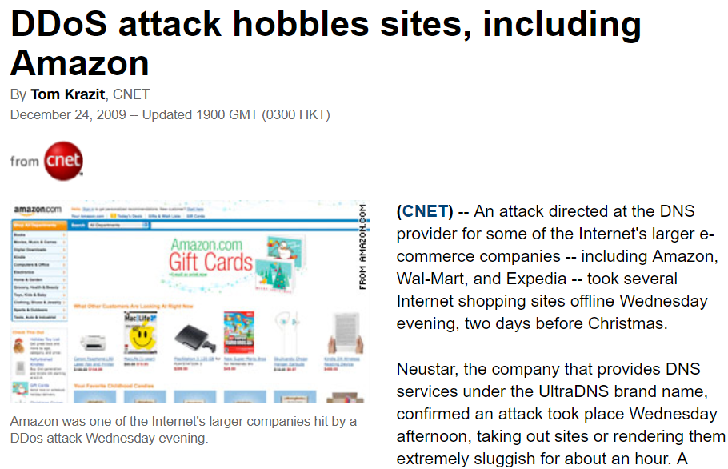
Attacks on Nameservers of a Particular Domain
UltraDNS: DNS provider for many major e-commerce companies such as Amazon, Walmart, Expedia. In 2004, DOS against this provider was launched which suffered an outage for an hour.

Slide 60
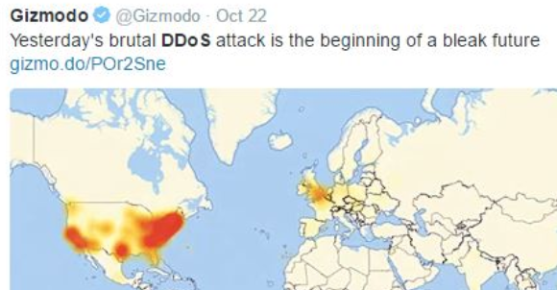
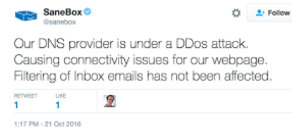
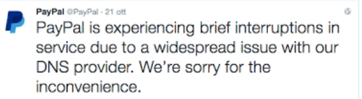
Attacks on Nameservers of a Particular Domain
Dyn network : In 2016, multiple DDoS attacks were launched against a major DNS service provider for companies like CNN, BBC, HBO, PayPal etc. The attacks are believed to have been launched through botnet consisting of different IoT devices like IP cameras, baby monitors etc. It caused major Internet services unavailable .

Slide 61
Attacks on Nameservers of a Particular Domain
DNSPod : In 2009, several DNS servers of a Chinese domain service provider were hit by DDoS.
The attack was meant to target one particular company (Baofeng.com) which is widely popular video streaming site in China.
On the next day of attack, when DNS responses previously cached by the other servers timed out, Baofeng’s media player on users’ machines could not find the IP addresses of the servers because of the attack.
Due to the bug in the media player software, instead of waiting, they continuously sent out DNS queries at a faster rate. Due to massive number of DNS queries, they flooded and congested the network of China Telecom (ISP). It impacted 20 provinces and is described as the worst Internet incident in China.

Slide 62
Summary
How DNS works
Spoofing Attacks on DNS
Local DNS cache poisoning attacks
Remote DNS cache poisoning attacks
Reply forgery attacks
Defense against DNS spoofing attacks
DNSSEC
TLS/SSL
Denial of Services on DNS

